Slide 1
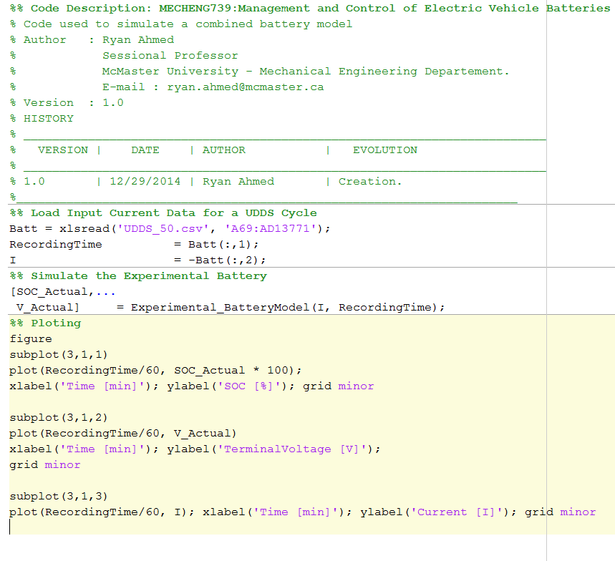
COMBINED MODEL MATLAB EXAMPLE: MATLAB SCRIPT
Combined Model Function Call

Slide 2
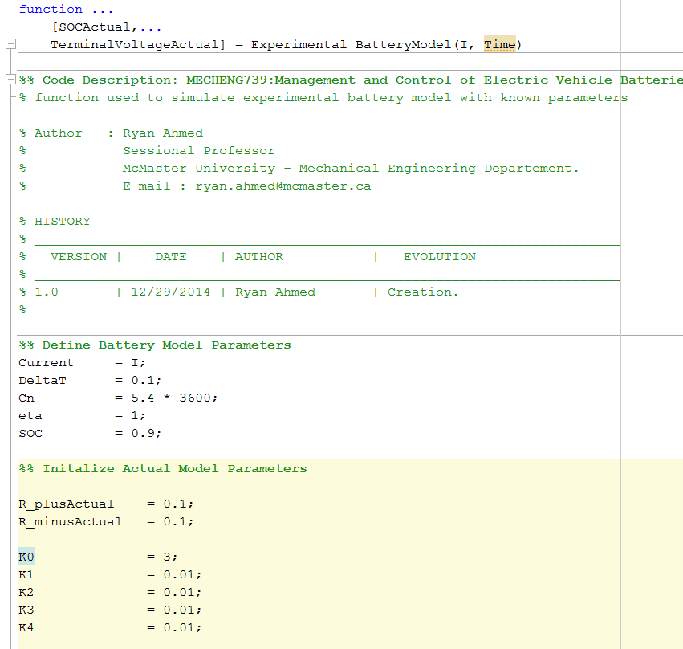
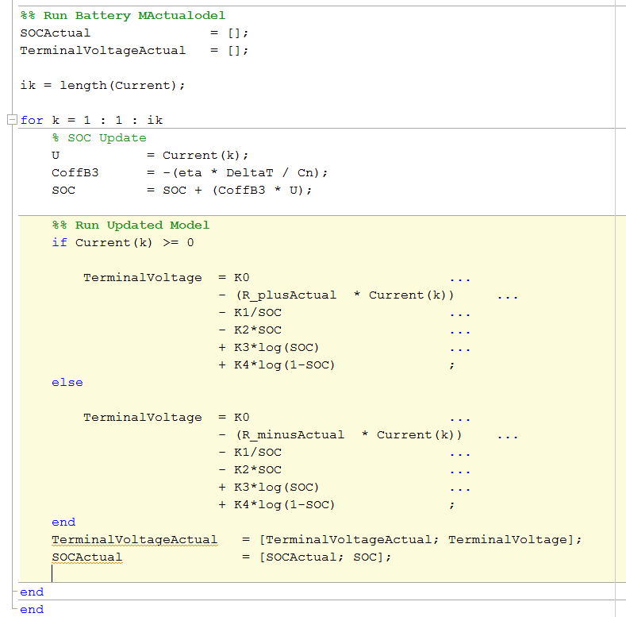
COMBINED MODEL MATLAB EXAMPLE: MATLAB SCRIPT
SOC Update
Terminal Voltage Calculation
Combined Model Parameters

Slide 3
COMBINED MODEL MATLAB EXAMPLE: SIMULATION RESULTS
UDDS cycle depleting a battery from 90% SOC to 85%
Discharge (acceleration)
and charge (Regenerative)

